Slide 1
AXA
GLOBAL BUSINESS SERVICES
Data modelling principles and techniques
Ashutosh Anand
Consultant –Data Modeling
DAAS- Data Management & Governance
15th May 2026- Bangalore

Slide 2
How many of you were involved in planning or making a new house/building recently?
Any Guess… What all the steps involved on high level before starting to build the building

Slide 3

Topic of Discussion
A high-level design of the building
Based on the requirement
4 rooms
parking space
storeroom
bla bla…
Our observation/Conclusion in Data World
The discussion or development is entirely focused on business requirements, whether current or future.
The design is purely conceptual.
Minimal technical details are involved
The discussions mainly involve non-technical stakeholders

Slide 4

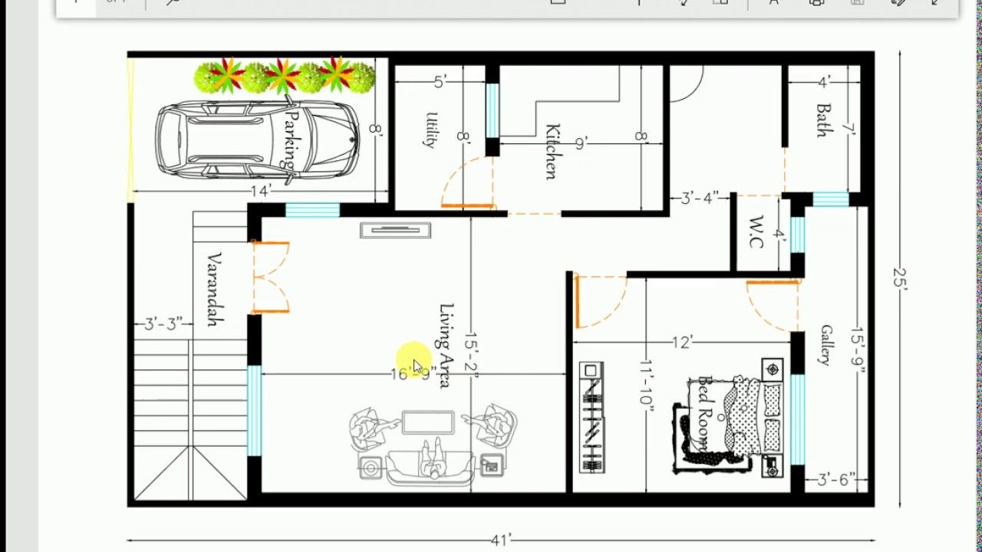
Civil engineer will understand the requirement.
He will provide more technical details and futuristic approach
He will logically create the model. This model still don’t exist in the real world and not can be utilized.
Data World
The model is created using a logical approach, but it does not yet exist.
It will include clearly defined tables, columns, and relationships once implemented.
The logical model can be reviewed by both technical and business personnel.
Typically, the logical model contains detailed names for fields and tables for clarity.

Slide 5

This is the model which actually exist in the real world. Which can be actually utilized by the stakeholders/users.
Physical data model in the Data world
The physical data model exists within the database.
It is used to store the actual data.
Created using Data Definition Language (DDL).

Slide 6
Agenda
What is Data modeling? Why is it required?
Data model Type (CDM,LDM,PDM)
OLTP Vs OLAP System
Dimensional modeling
Star Schema vs Snowflake Schema
Data Vault modeling
Definition of Commonly used Key fields
Overview of Data Architecture

Slide 7
What is data modeling and Why modeling required?
Organizes Data Structure: Provides a clear framework for how data is stored, organized, and related within a system.
Improves Data Quality: Ensures consistency, accuracy, and integrity of data by defining rules and standards.
Supports Data Integration: Enables easier integration of data from different sources by providing a unified data structure.
Reduces Redundancy and Duplication: Helps in normalizing data to eliminate redundancy and improve storage efficiency.
Facilitates Better Decision Making: By ensuring high-quality, well-structured data, it enables more accurate analysis and insights.
Aids in Data Governance: Supports data management policies, security, and compliance requirements.

Slide 8
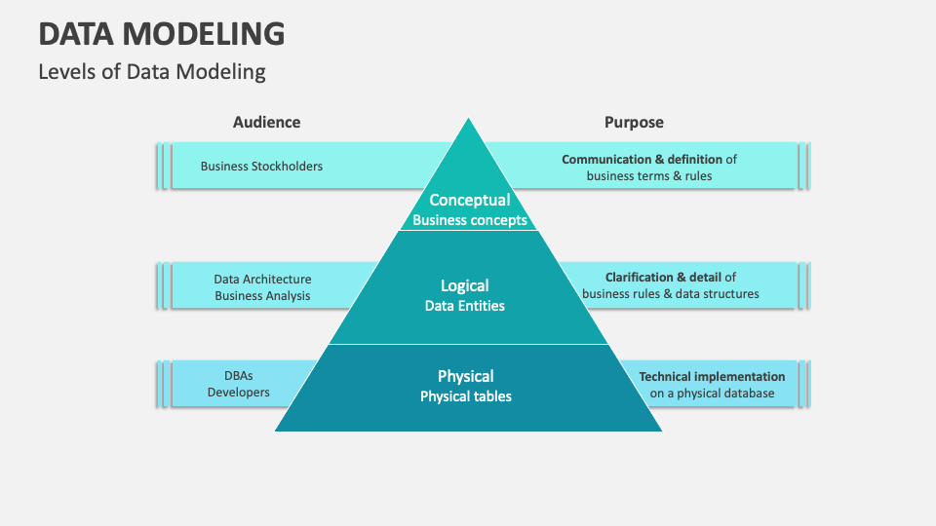

Slide 9
OLTP System Vs OLAP System
OLTP System | OLAP System
ER Diagram/Normalized Model | Dimensional modeling(Star&Snowflake),Data Vault modeling
Normalized | De-normalized
Designed for transactional data storage | Designed for Analytical data storage
Transaction data | Aggregated data
Short term data storage(3 month-1 year) | History data(3-10 years)

Slide 10
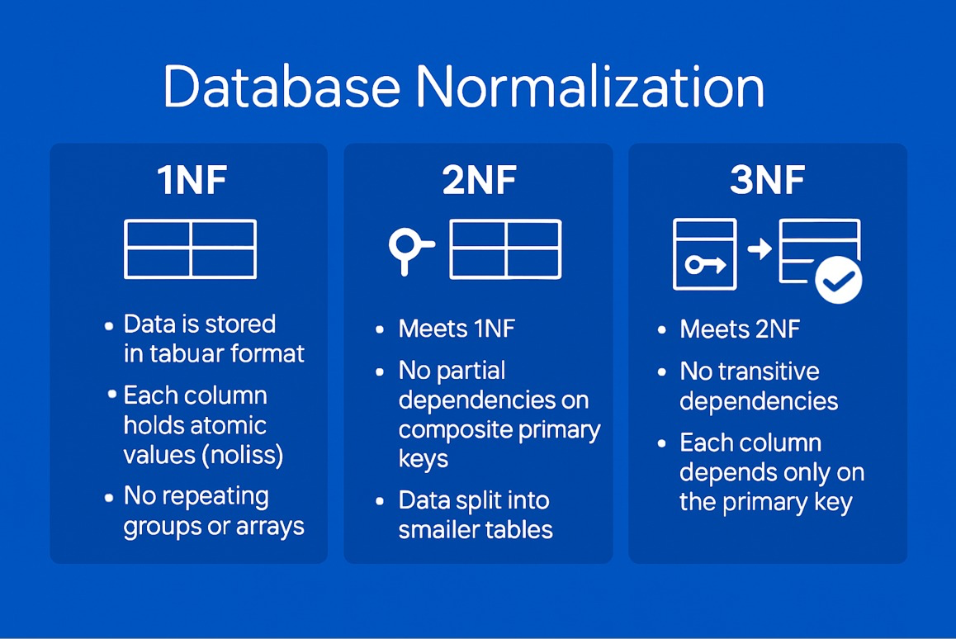

Slide 11
Dimensional Modeling
This is a OLAP modeling technique, It organize the data for fast querying,reporting and analytics.
It structure the data into
Fact tables – which store measurable business data
Dimensional tables – store descriptive context about the business idea.
Star Schema
Fact table at the center
Directly connected dimension table
Simple and fast
Relatively more denormalised than Snowflake
Snowflake Schema
Fact Table at the center
Dimension tables are normalized into sub-dimensions
More Complex but reduce redundancy
Relatively more normalized than Star

Slide 12
Dimensional modeling(Star Schema)-Example
Dim_Product
Product_Id(PK)
Product_Name
Product_Type_Code
Fact_Policy_details
Fact_policy_detail_Key(PK)
Policy_Id(FK)
Customer_Id(FK)
Product_Id(FK)
Policy_Start_Date
Commission_Amount Premium_Amount
Dim_Customer
Customer_Id(PK)
Customer_Name
Customer_Addr_1_Text
Customer_Addr_2_Text
Pin_Code
State_Name
Country_ISO_Code
Country_Name
Dim_Policy
Policy_Id(PK)
Policy_Name
Product_Type_Code

Slide 13
Dimensional modeling(Snowflake Schema)-Example
Dim_Product
Product_Id(PK)
Product_Name
Product_Type_Code
Fact_Policy_details
Fact_policy_detail_Key(PK)
Policy_Id(FK)
Customer_Id(FK)
Product_Id(FK)
Policy_Start_Date
Commission_Amount Premium_Amount
Dim_Customer
Customer_Id(PK)
Customer_Name
Customer_Addr_1_Txt
Customer_Addr_2_Txt
Address_Id(FK)
Dim_Location
Location_Id(PK)
Pin_Code
State_Code
Country_Code
Country_Name
Dim_Policy
Policy_Id(PK)
Policy_Name
Product_Type_Code

Slide 14

Types of Dimension table and Fact table
Fact table
Transactional Fact
Periodic Snapshot fact
Accumulating Snapshot Fact
Dimension table
Conformed dimension
Slowly Changing dimension
Role playing dimension
Degenerate dimension
Junk dimension

Slide 15
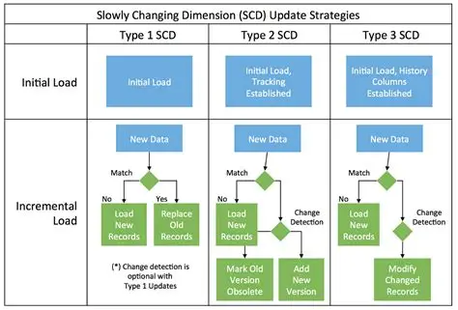
SCD type and Update strategy

Slide 16
Data Vault Modeling
Data Vault modeling methodology used to build scalable,auditable and flexible enterprise data platforms – specially for analytical and historical tracking purpose.
Core components in Data Vault
Hub – stores unique business value
Satellite – stores descriptive attribute and historical changes
Link – stores relationships between hubs
Symbolic Diagram: How Dimensional Modeling Differs from Data Vault Modeling
Sat
Hub
Hub
Sat
Dimension
Dimension
Link
Fact
Sat

Slide 17
Data Vault modeling
Customer_Sat
Customer_Hub_Key(PK)
Customer_Name
Customer_Addr_1_Text
Customer_Addr_2_Text
Pin_Code
State_Name
Country_ISO_Code
Country_Name
Audit fields…
Policy_details_Link
Policy_details_Link_Key
Policy_Id(PK)
Customer_Id(PK)
Product_Id(PK)
Audit fields
Product_Sat
Product_Hub_Key(PK)
Product_Name
Product_Type_Code
Audit_fields…
Product_Hub
Product_Hub_Key(PK)
Product_Id
Audit fields…
Customer_Hub
Customer_Hub_Key(PK)
Customer_Id
Audit fields…
Policy_details_Sat
Policy_details_Link_Key
Policy_Start_Date
Commission_Amount Premium_Amount
Audit fields
Policy_Sat
Policy_Hub_Key(PK)
Policy_Name
Product_Type_Code
Audit fields…
Policy_Hub
Policy_Hub_Key(PK)
Policy_Id
Audit fields…

Slide 18
Dimensional Modeling vs Data Vault
Dimensional modeling
Deformalized
Simple and easy to understand
Fast performance
More focused toward data mart/visualization
Not as scalable
Data redundancy
Data Vault modeling
Hybrid of 3NF and Dimensional modeling
Normalized
Scalable
More focused toward enterprise data, scalability
Parallel data load
High complexity
Slow Query and performance

Slide 19
Commonly used Key fields and their definition
Primary Key – A field (or combination of fields) that uniquely identifies each record in a table. Cannot contain NULL Values.
Foreign Key – A field in one table that links to the Primary Key in another table, creating relationships between tables.
Candidate Key – A field that can uniquely identify records and could potentially become the Primary Key.
Surrogate Key – An artificial/system generated key with no business meaning, usually auto-incremented.
Hub Key – A field which is generated by using hash function over Business key. (Terminology used in Data vault modeling)
Hash Key – A field generated using hash function over the source column data. (Generally used to compare in case new record get inserted)

Slide 20
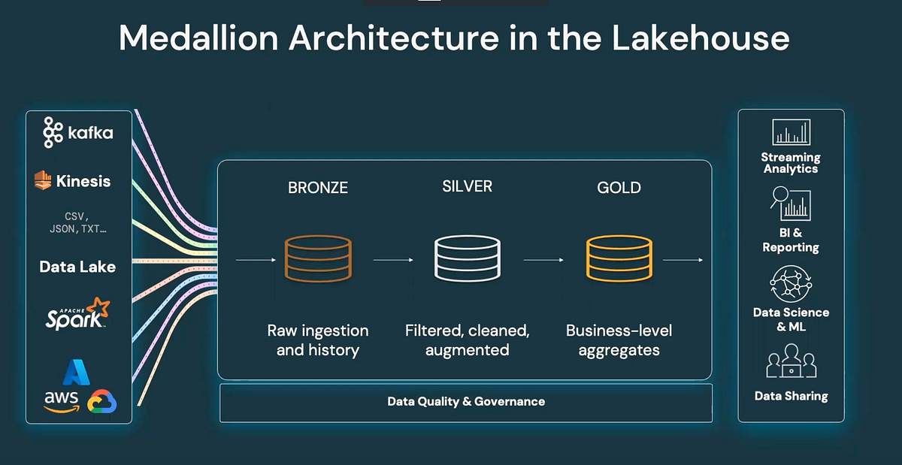
Data architecture
Medallian architecture

Slide 21
At which layer modeling required?
src1
Bronze Layer
Silver Layer
Gold layer
Visualisation layer
src2
src3

Slide 22

Q&A

Slide 23
Thank You

